Slide 1
2023 Intern Final Presentation
Ethan Rudometkin

Slide 2
Project Introduction
ERP Software: Oracle Enterprise Resource Planning (ERP)
Component: Oracle ESS (Enterprise Scheduler Service)
Purpose: Manages business operations - finance, human resources, supply chain, etc.
ERP Quarterly Updates and Issue: Deliver new features, bug fixes, and security updates through regular quarterly releases. However, potential data inconsistency and system slowdown issues can arise from overlapping task execution during these updates.
Notes:
My project dealt with the Oracle Enterprise Resource Planning (ERP) software which is used to to manage its business operations, including finance, human resources, supply chain, and other processes. Oracle ESS (Enterprise Scheduler Service) is a component within the Oracle ERP system that handles job scheduling and execution.
The Oracle software has a standard practice of a quarterly update where they may release new items. The problem for Servco is that some jobs continue to run at the same time as the quarterly update. This causes various issues. Data inconsistency, system slowdown, and unexpected system behavior.

Slide 3
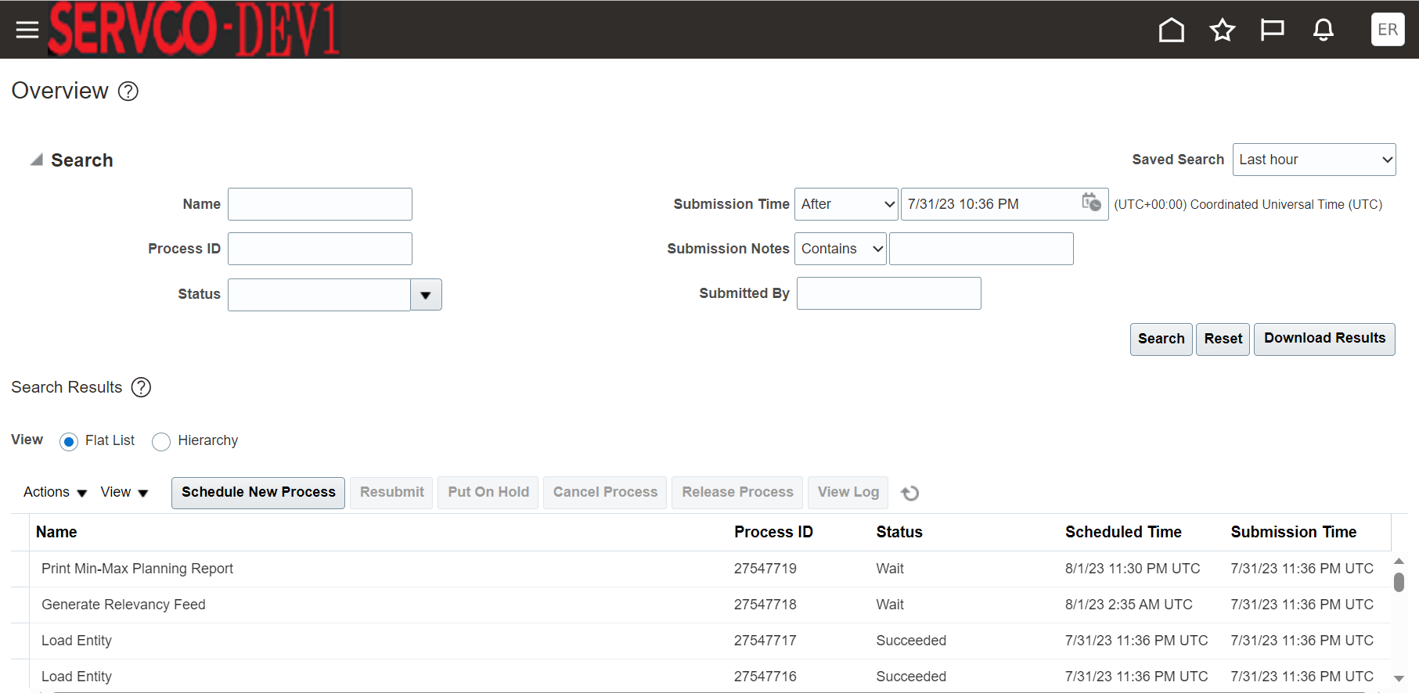
Notes:
Oracle ESS offers a web-based user interface where you can configure, schedule, and monitor the jobs and processes.
As of now to handle the issue, Servco has to put the jobs on hold and releasing jobs off hold manually using the ESS interface
This means that employees or administrators have to go into the tool and pause the jobs one by one during the Oracle ERP quarterly update. After the update occurs then they must release jobs off hold so the system can run smoothly This manual approach has several drawbacks and challenges.
Manually pausing each job takes time, especially if there are numerous jobs to be put on hold. This can extend the overall system downtime during the update process, impacting business operations and productivity.
There is a risk of human error during the manual intervention. Mistakes can happen while pausing or resuming jobs, leading to incorrect job statuses or unexpected behavior once the jobs are released from hold. Moreover, the manual process might be prone to inconsistencies in handling different jobs, and it could be challenging to keep track of which jobs have been paused and which have not.

Slide 4

Project Solution
Recommended using SoapUI for automation and interaction with the Oracle ESS scheduler tool.
SoapUI supports SOAP requests, enabling communication with the Oracle ESS API for performing tasks programmatically.
Notes:
- To solve this issue I was recommended that I use SoapUI which is a tool that can be utilized for automation and interacting with web applications like the Oracle ESS scheduler tool. Since SoapUI supports SOAP (Simple Object Access Protocol) requests, it can communicate with the Oracle ESS API and perform tasks programmatically.

Slide 5
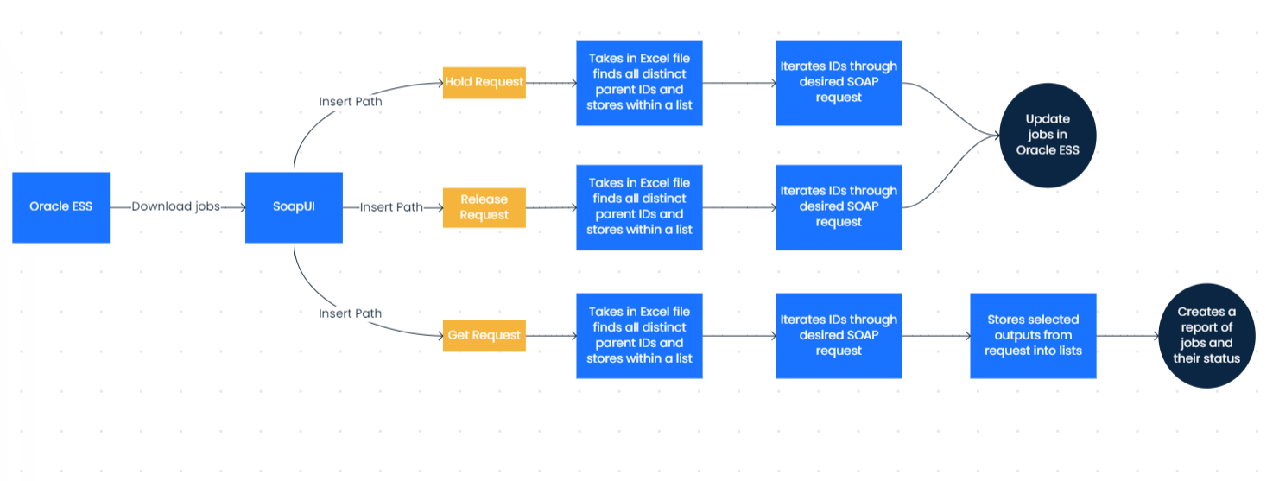

Slide 6

Project Contribution to Servco
Automation with SoapUI reduces system downtime by efficiently scheduling job pausing before the quarterly update
The elimination of manual intervention through automation eliminates human error
Notes:
- Automation with SoapUI reduces system downtime by efficiently scheduling job pausing before the quarterly update, minimizing its impact on business operations.
- The elimination of manual intervention through automation eliminates human error, ensuring accurate and consistent handling of job pausing and resuming tasks during the update process.

Slide 7
Key Takeaways
Skill Enhancement: Strengthened proficiency in SoapUI and Oracle ESS, enabling effective automation and API integration. Gained experience in Linux and Putty for Oracle system management.
Operational Insight: Gained valuable understanding of Company Servco's operations through parts center tour. Witnessed practical use of Oracle tech in daily processes.
Team Collaboration: Improved teamwork, communication, and troubleshooting in collaborative hackathon. Developed unified approach to achieving shared objectives.

Slide 8
Thank you!

